Slide 1
METALWORK TOOLS
Marking out Tools
Measuring Tools
Driving Tools
Cutting Tools
Holding Devices

Slide 2
Marking out Tools
Marking out tools are hand tools used for marking lines on metal surface, checking alignment, indicating points/positions on a workpiece.
Some of the marking out tools are surface plate, surface table, scriber, odd-leg callipers, dividers, punches and try square
Surface plate: it is made of cast iron, it is used for testing flatness of surfaces.
Surface table: it is made of cast iron, it is used for supporting bigger workpiece and for checking flatness of bigger workpiece for marking out purposes.

Slide 3
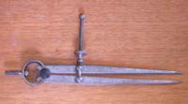
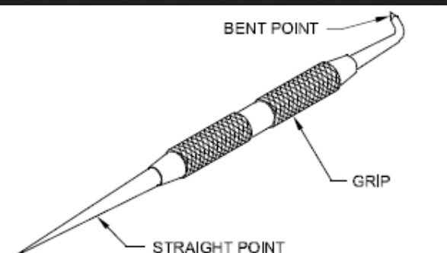
Marking out Tools

Slide 4
Measuring Tools
They are those tools used for measuring lengths, widths, thickness or sizes of metal
Some of the measuring tools are steel rule, callipers, combination sets, micrometer, vernier callipers, depth gauge and height gauge.
Steel rule: it is made of carbon steel/stainless steel. It is the commonest measuring instrument calibrated in millimetre and centimetre
Callipers: they are used for measuring diameters, widths and thickness. They include external, internal and odd-leg callipers.
Micrometer: it is used for precision measurements. It consists of spindle, thimble and barrel.

Slide 5
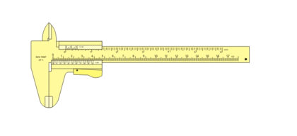
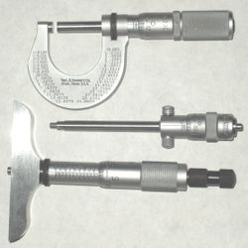
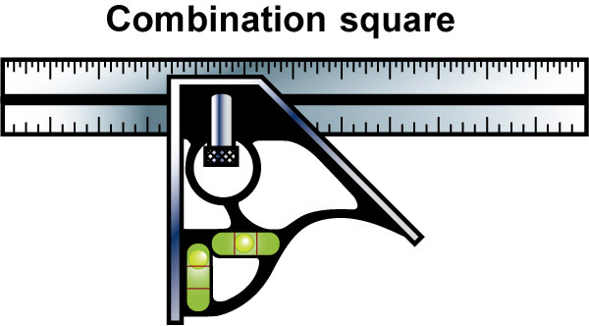
Measuring Tools

Slide 6
Cutting Tools
They are tools used for cutting materials by sawing, filling, chiselling or scraping.
Some of the common metalwork cutting tools are hacksaw, file, chisel and scrapper.
Hacksaw: it is used for cutting metals. The three types of hacksaw are adjustable, tubular and junior hacksaw. The two types of hacksaw blade are flexible and all-hard blade.
Files: they are made from high carbon steel, and are used for finishing jobs to the required sizes and shapes after they have been previously cut using chisel or hacksaw. Some of the types of files are flat, hand, round, half-round, triangular, knife-edge and square file.

Slide 7
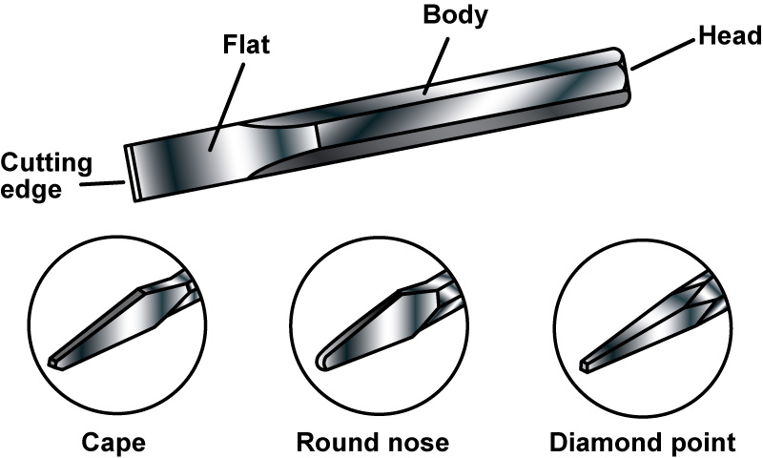
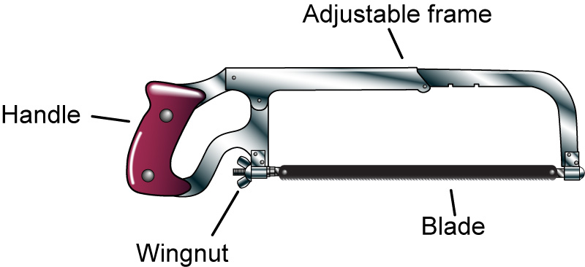
Cutting Tools

Slide 8
Driving Tools
These are tools used for moving objects into metals through hammering, punching or screwdriving. Some of the commonly used driving tools are hammers, screwdriver and punch.
Hammers: they consist of the head and the handle. They are used for delivering blows on a workpiece, some of the types of hammer are ball pein, cross pein, straight pein and mallet.
Punches: they are used for punching holes on metals, driving out rivet/pin/dowels from holes. The three main types of punches are pin, round, square punches.

Slide 9

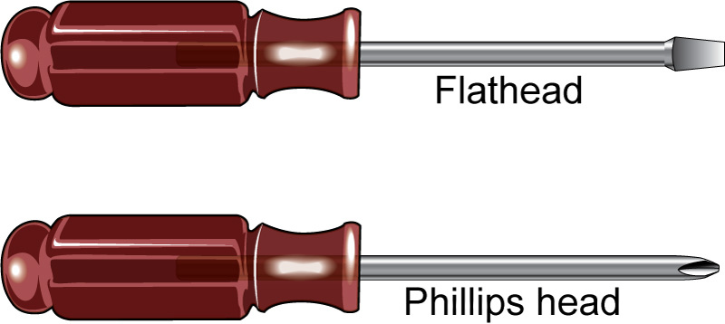
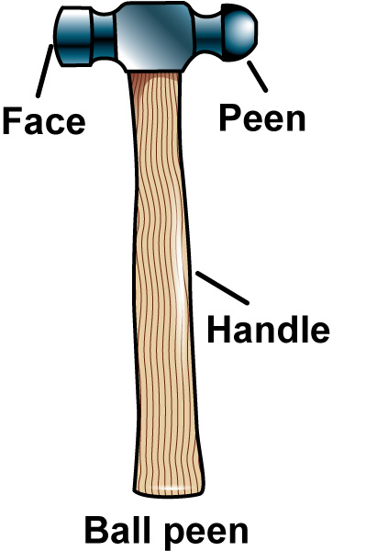
Driving Tools

Slide 10
Holding Devices
They are used to firmly secure workpiece at a fixed position when working with metals. They include bench vice, hand vice, machine vice, pliers and G-clamp.
Vices: they are used for holding objects rigidly in position so that desired operations can be carried out. Some types of vices are bench, machine, hand and leg vice.
Clamps: they are used for holding workpiece for various jobs. The three main types of clamps are pliers(long nose, round nose, flat nose, combination pliers), toolmaker’s clamp and G-clamp

Slide 11


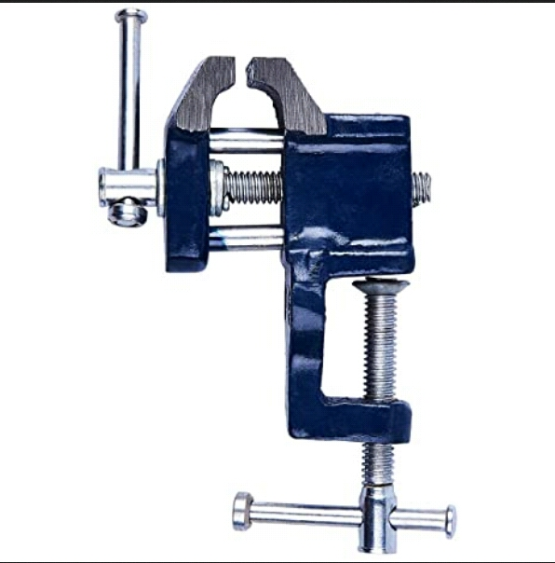
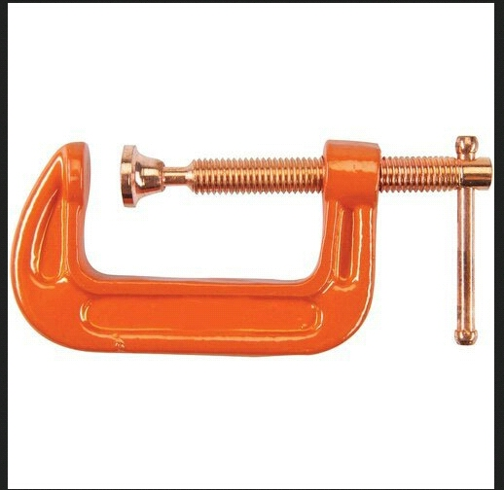
Holding Devices

